Slide 1
2024 Program Administrator Update
KSBN Staff

Slide 2
KSBN Mission
The mission of the Board of Nursing is to assure the citizens of Kansas safe and competent practice by nurses and mental health technicians.

Slide 3
AGENDA - Update
KSBN Executive Administrator Update
KSBN Licensing / Investigative Issues
KSBN Operations Update
KSBN Licensing Update
KSBN Education Update

Slide 4
Executive Administrator Update
Carol Moreland, MSN, RN

Slide 5
KSBN Licensing Application Review Process
Evan Faulkner,
Sr. Special Investigator

Slide 6
Application Process
Evan Faulkner
Senior Special Investigator

Slide 7
INITIAL APPLICATION CHECKLIST
Official Transcripts
Fingerprints and the background check fee
Registration to take the NCLEX
Certified Court Documents
If applicable
Explanatory Letter
If applicable

Slide 8
Applying for Multi-State:
Uniform Licensure Requirements for a Multi-State License
Meets the requirements for licensure in the home state (state of residency);
Has graduated from a board-approved education program; or
Has graduated from an international education program (approved by the authorized accrediting body in the applicable country and verified by an independent credentials review agency);
Has passed an English proficiency examination (applies to graduates of an international education program not taught in English or if English is not the individual's native language);
Has passed an NCLEX-RN or NCLEX-PN Examination or predecessor exam;
Is eligible for or holds an active, unencumbered license (i.e., without active discipline);

Slide 9
Applying for Multi-State:
ULR cont.
Has submitted to state and federal fingerprint-based criminal background checks;
Has no state or federal felony conviction or found guilty, or has entered into an agreed disposition, of a felony offense under applicable state or federal criminal law;
Has no misdemeanor convictions related to the practice of nursing (determined on a case-by-case basis);
Is not currently a participant in an alternative program;
Is required to self-disclose current participation in an alternative program; and
Has a valid United States Social Security number.

Slide 10
Reporting legal history on application
Convictions
If you have been convicted of a misdemeanor and/or felony, certified/dated copies of court documents are REQUIRED for EACH conviction.
If the court does NOT have documents anymore, a letter from the courthouse needs to be submitted with the information stating they no longer have record.
Explanatory Letter
You are REQUIRED to submit an explanatory letter regarding EACH conviction and/or disciplinary/administrative action when it is first reported.
Disciplinary Action
If you have been disciplined by any other Board (e.g. professional licensure) or governmental agency (e.g. Department of Health and Environment regarding CNA, CMA, or HHA certification, you are REQUIRED to provide a certified/dated copy of that Board order or disciplinary/administrative action.
Legal History Known to KSBN
KSBN has a record retention policy, and we should not be relied upon to be the source for anything that is in the applicant’s past. It should be the applicant's responsibility to maintain their records.

Slide 11
REPORTING LEGAL HISTORY CONT.
Pending Legal History
If you have a pending criminal charge for a misdemeanor and/or felony offense that is not final in the court system, what do you need to submit?
Documents to produce
Petition, Notice of Hearing, and/or Ticket
If actively in a Diversion Agreement/SIS:
Certified court documents
Diversion agreement
Explanatory letter
Has not had court date
Explanatory letter
Once an outcome has been determined with the courts, licensee/applicant is required to inform KSBN within 30 days.
pursuant to K.S.A. 65-1117(c)(1)

Slide 12
Explanatory letter
The explanatory letter should include the following information:
Date of the criminal offense or disciplinary/administrative action
Circumstances leading up to the arrest or disciplinary/administrative action
Actual conviction or disciplinary/administrative action
Actual sentence or board/regulatory agency order
Current status of sentence or order
Rehabilitation (if any)

Slide 13
OBTAINABLE DOCUMENTS
The following list is not all inclusive but represents the types of court documents that can be obtained from the office of the Clerk of the Court where the conviction/diversion occurred – City (municipal), County (district/circuit) or Federal Court:
Uniform Notice to Appear and Complaint (e.g. ticket), Complaint/Petition or Indictment:
DO NOT submit information regarding speeding or parking tickets
Amended Complaint/Petition or Indictment
Indicates chargers were increased/decreased from the original charges
Journal Entry of Judgment (Conviction) and Sentencing
Probation Agreement (if any) and current status
Diversion Agreement (if any) and current status
Proof that all fines, fees, costs and/or restitution have been paid or record of payment to date

Slide 14
Subject to reporting
ALL felonies
And the following categories of misdemeanors;
Alcohol
Any drugs
Deceit
Dishonesty
Endangerment of a child or vulnerable adult
Falsification
Fraud
Misrepresentation
Physical, emotional, financial, or sexual exploitation of a child or vulnerable adult
Physical or verbal abuse
Theft
Violation of a protection from abuse order or protection from stalking order; or any action arising out of a violation of any state or federal regulation

Slide 15
Agreed disposition
An agreed disposition means the disposition of a Complaint or Charge of Misconduct agreed to by Respondent and Bar Counsel and approved by a Subcommittee, District Committee, or the Board
https://www.lawinsider.com/dictionary/agreed-disposition.
Examples of an agreed disposition
Diversion Agreement
Suspended Imposition of Sentencing (SIS).

Slide 16
Felony conviction/agreed disposition
Am I eligible for a Multi-State License?
My agreed disposition is for a felony offense.
NOT ELIGIBLE
Felony conviction on record
NOT ELIGIBLE
Felony conviction/agreed disposition expunged?
Expungement documents must be submitted along with explanatory letter
Application gets reviewed by Board Chairperson for approval of licensure.
Am I eligible for a Single-State License?
All felony convictions and/or agreed dispositions will be reviewed by Board Chairperson for approval of licensure.

Slide 17
Misdemeanor conviction/agreed disposition
Am I eligible for a Multi-State License?
Conviction/agreed disposition has a nexus to nursing?
NOT ELIGIBLE
Conviction/agreed disposition does not have a nexus to nursing?
Eligible with approval from Board Chairperson
Am I eligible for a Single-State License?
All misdemeanor convictions will be reviewed by Board Chairperson for approval of licensure.

Slide 18
Monitoring program
What is an approved monitoring program?
Kansas Nurse Assistance Program (KNAP)
www.ksnurseassistance.org/
Established in 1988, the Kansas Nurse Assistance Program works with healthcare professionals across the state of Kansas to provide monitoring services to ensure public safety and rehabilitation of the struggling nurse.
KNAP is a voluntary program that assists in the rehabilitation of healthcare professionals while still attaining their professional licenses and serves LPNs, RNs, LMHTs, APRNs, and CRNAs struggling with substance abuse, mental heath issues, or decreased cognitive functioning.

Slide 19
Monitoring program cont.
Monitoring Program is NOT
KSBN monitoring your license
Nursing program
Clinical rotation
KNAP Contacts
Jennifer Payea, MS– KNAP Executive Director
Elizabeth Anderson, BSW, MSW – KNAP Program Manager
Lindsey Grainger – Administrative Assistant

Slide 20
NCLEX TESTING ACCOMMODATIONS REQUESTS
Collect Documentation
Documentation must include the following:
A professionally recognized diagnosis must be included in the documentation which the board receives from the candidate
A history of the disability and any past accommodation granted the candidate and a description of its impact on the individuals functioning.
Identification of the specific standardized and professionally recognized test/assessment given (e.g., Woodcock-Johnson, Weschler Adult Intelligence Scale).
The scores resulting from testing, interpretation of the scores and evaluations.
Recommendations for testing accommodations with a stated rationale as to why the requested accommodation is necessary and appropriate for the diagnosed disability (NCSBN 2007).
Acquire Program Director’s Statement
A written statement from the candidate’s Program Director (or designee) which describes any testing accommodations made while the student was enrolled in the program.
Send Application
A letter from the applicant requesting specific special accommodations and the accompanying documentation for the need of the accommodations must be submitted to the Kansas Board of Nursing with your application to test. The accommodations will be reviewed for approval by the Board Chairperson at the weekly application meeting.

Slide 21
QUESTIONS?

Slide 22
KSBN Operations & IT
Adrian Guerrero, CPM

Slide 23
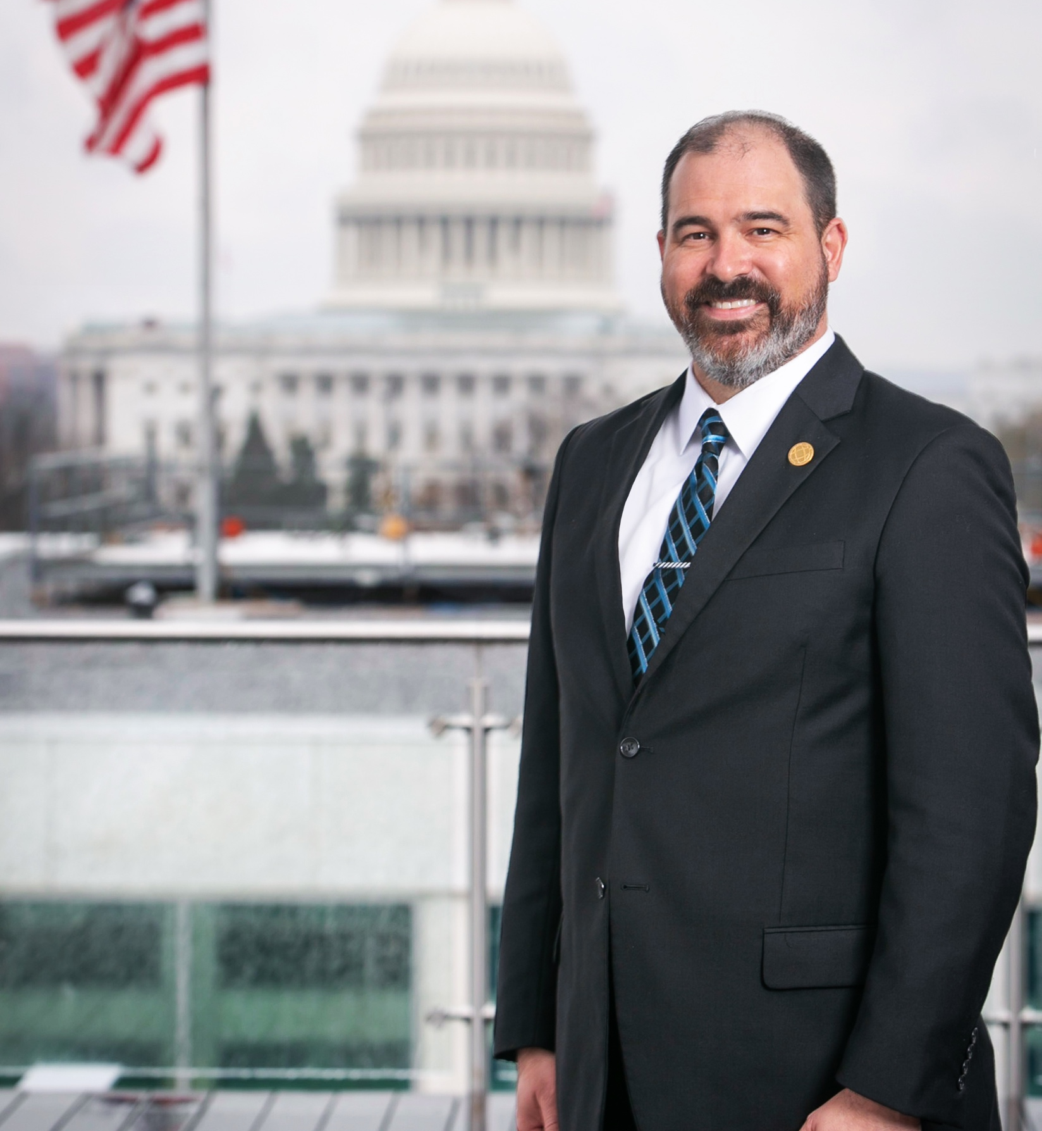
Welcome!
Adrian Guerrero, CPM
Desk Phone: 785-296-5935
Email: adrian.guerrero@ks.gov

Slide 24
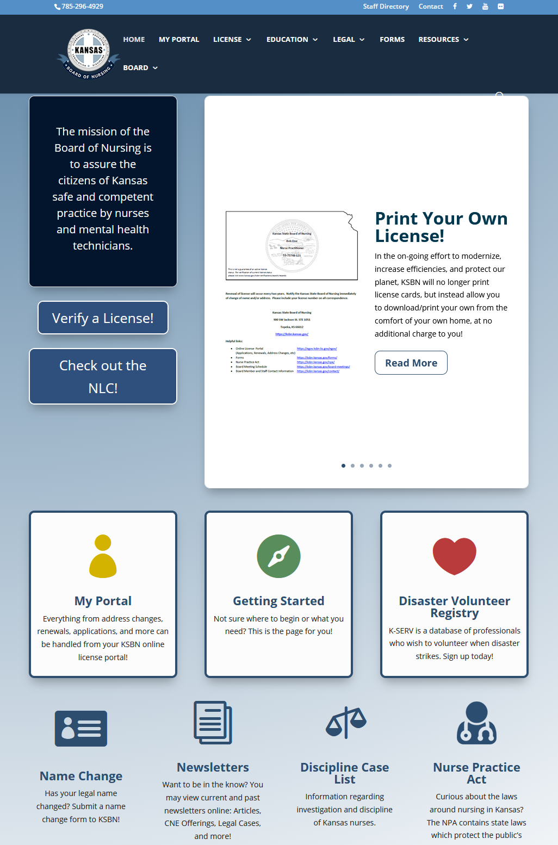
KSBN Services
Online Applications | Nurse Portal
Renewals
KANN Check | Status Verifications | eNotify
Online Education Annual Report
KANNalert
Alexa
CNE Web Forms
Newsletter
All services available via https://ksbn.kansas.gov/

Slide 25
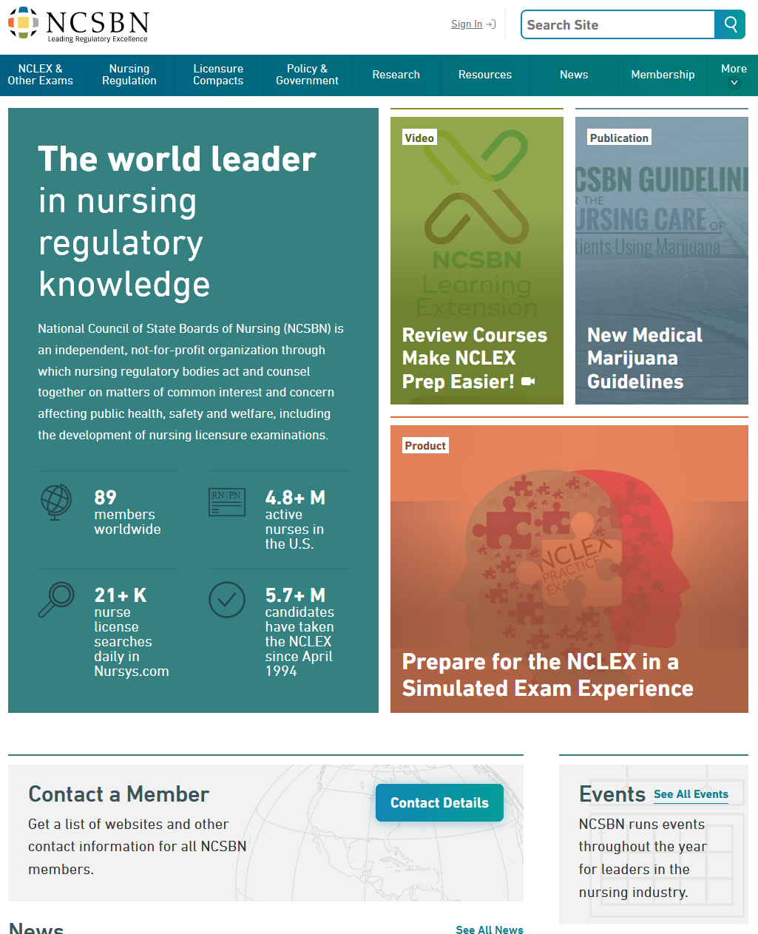
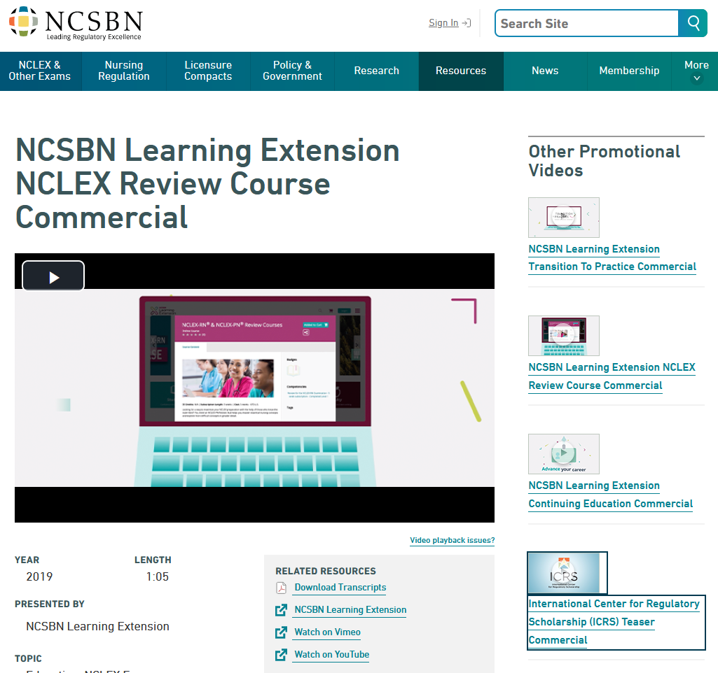
National Council of State Boards of Nursing - NCSBN.org

Slide 26
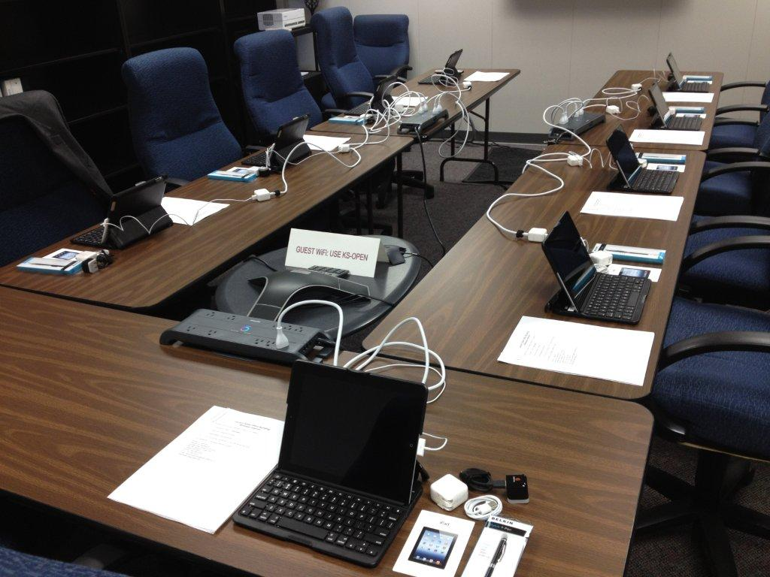
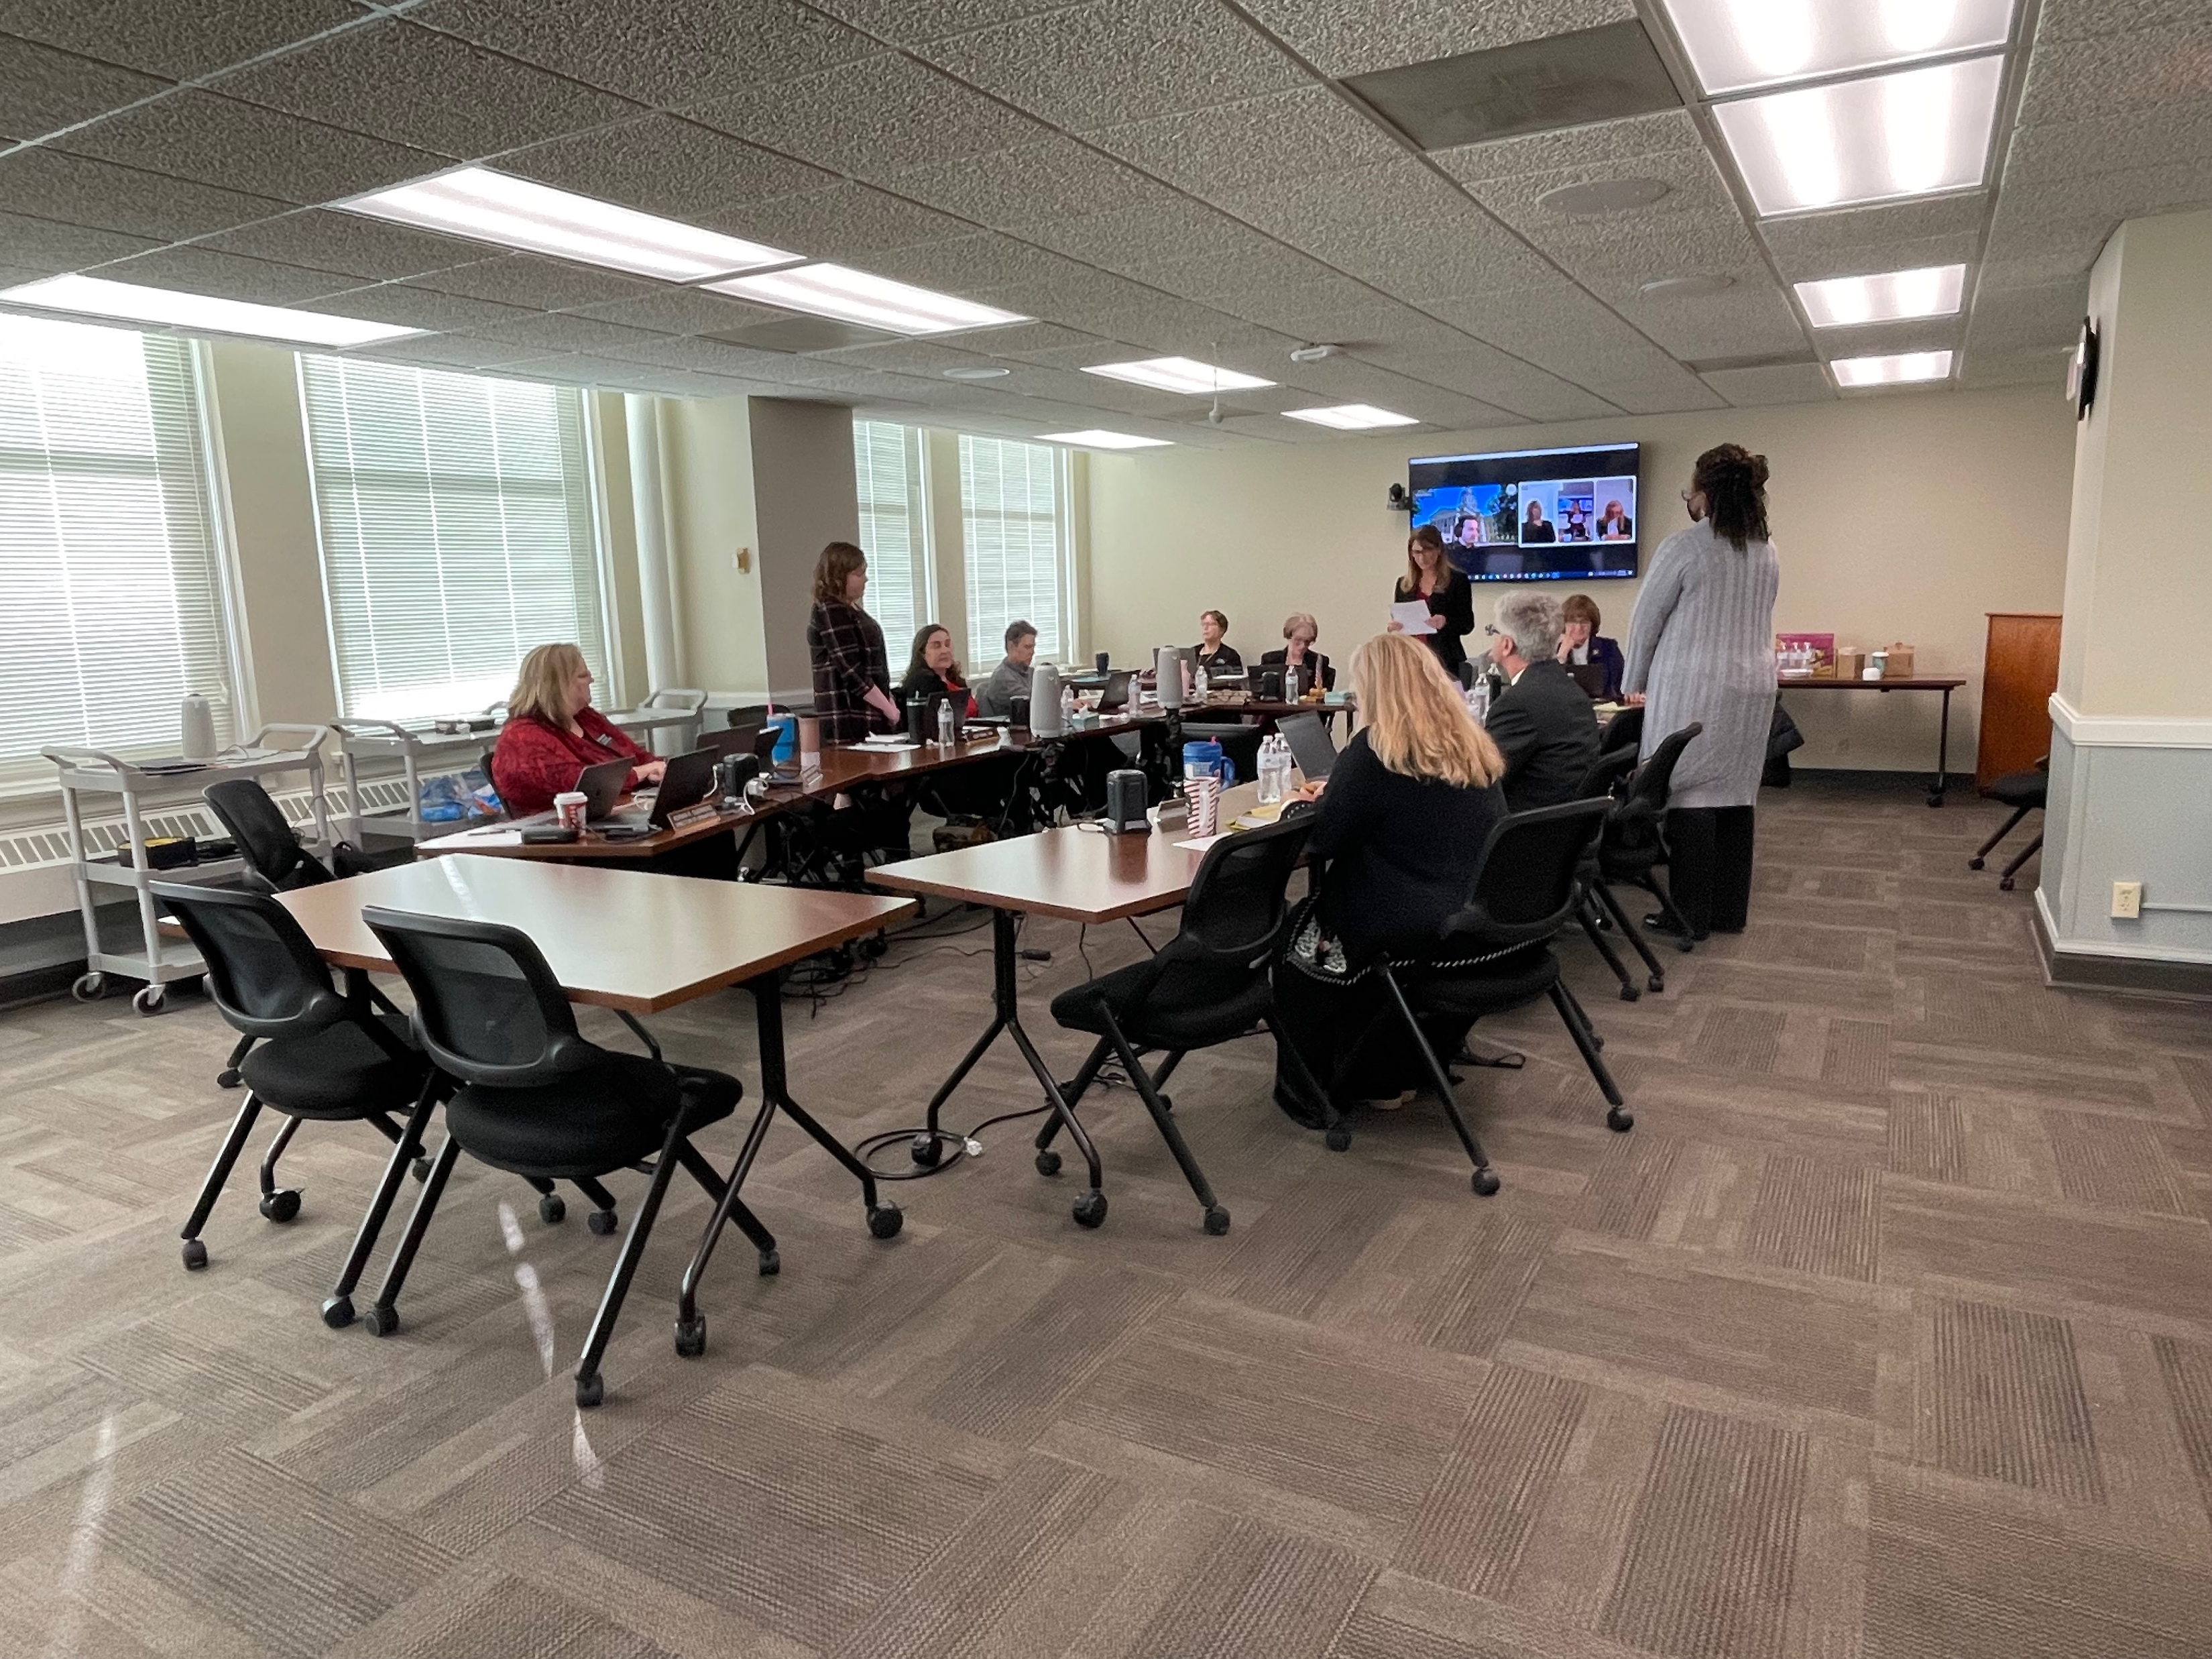
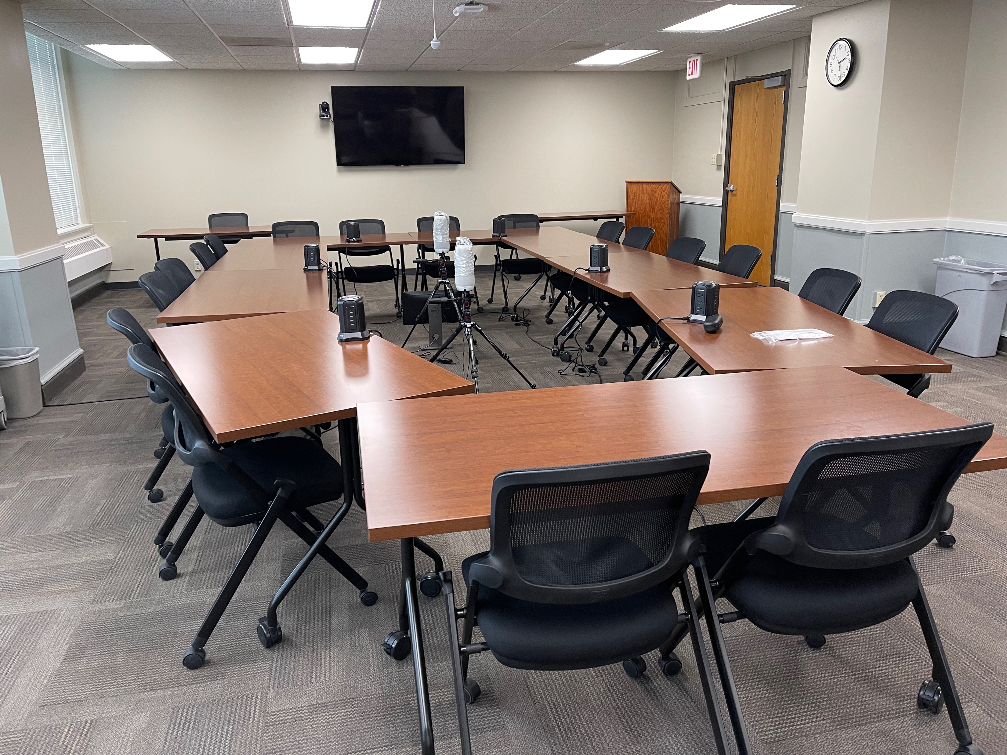
Email / Laptop / WIFI
KSBN Board Members will be issued a State Kansas O365 Email Address & Board Laptops
The State of Kansas WIFI is KS-OPEN (Public WIFI)

Slide 27
Initial Application Process
RaeAnn Byrd
Licensing Supervisor

Slide 28
Licensing Division Contacts:
Jackie Mercer
Senior Administrative Assistant Front Desk jackie.mercer@ks.gov 785-296-2967
Barbara Bigger
Senior Administrative Assistant Renewals, Reinstatements Data Records Archives barbara.bigger@ks.gov 785-296-2926
Karen McGill ***
Senior Administrative Assistant LPN and RN Applications/NCLEX karen.mcgill@ks.gov 785-296-2453
RaeAnn Byrd, CPM
Licensing Supervisor Endorsements, Advanced Practice raeann.byrd@ks.gov 785-296-6573

Slide 29
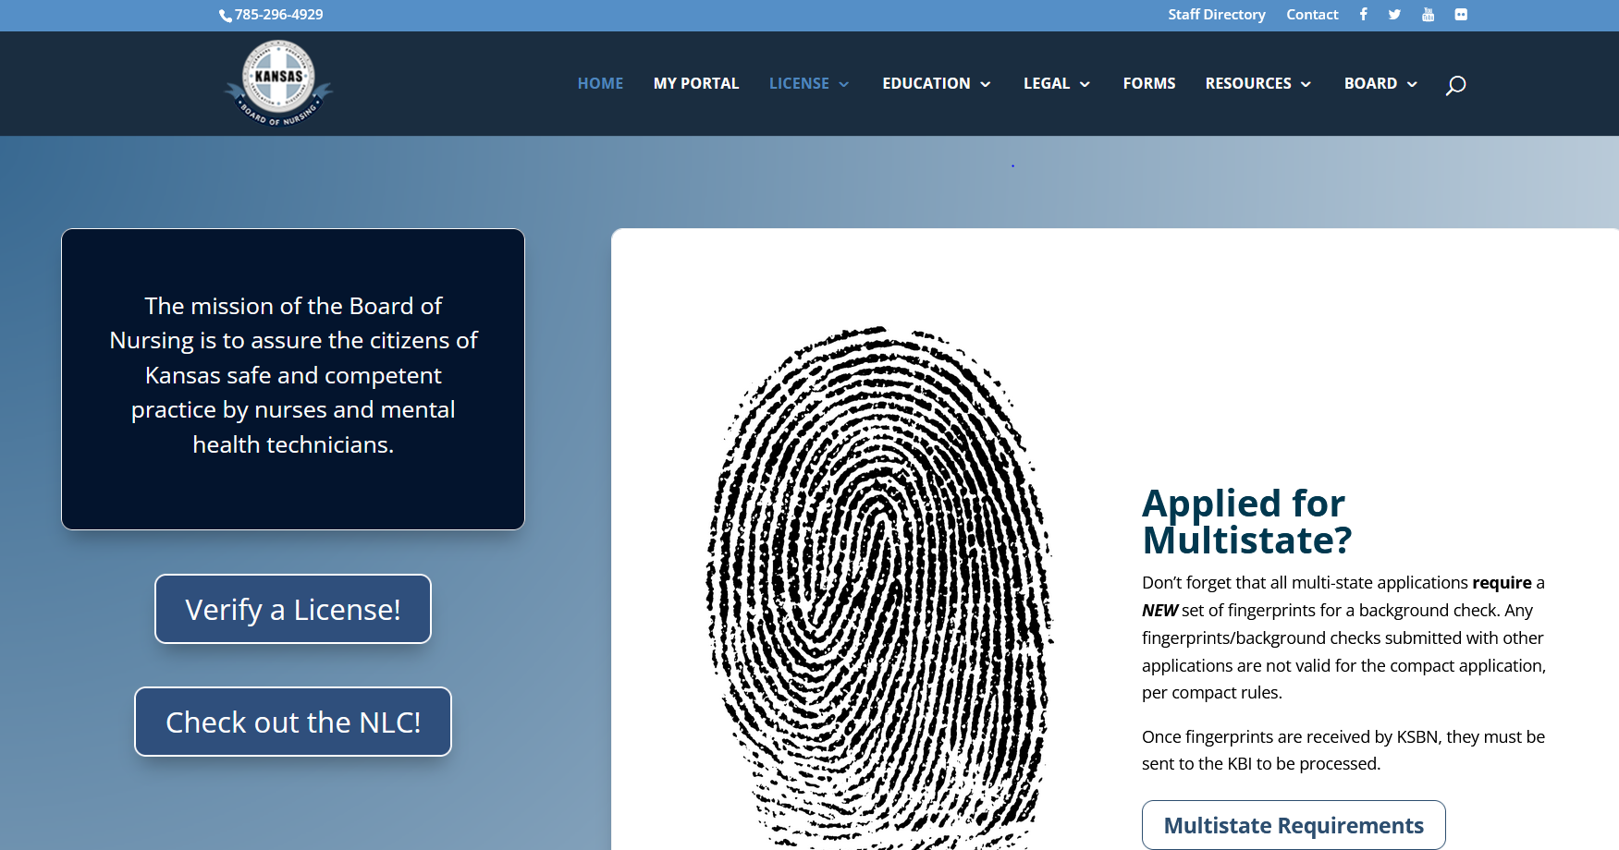
Kansas Board of Nursing website: https://ksbn.kansas.gov/

Slide 30
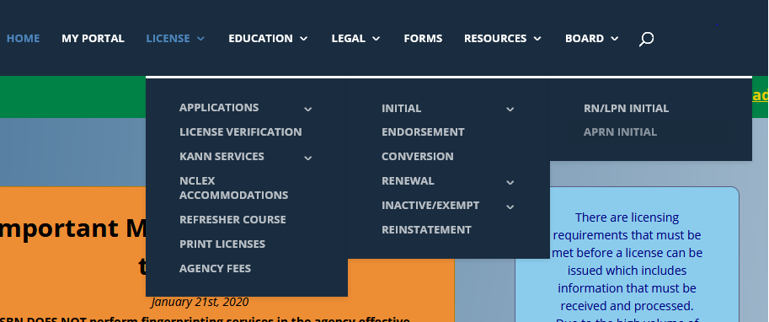
How do I get to the initial application?
Hover over License in the toolbar, then Applications, then Initial, then LPN/RN Initial

Slide 32
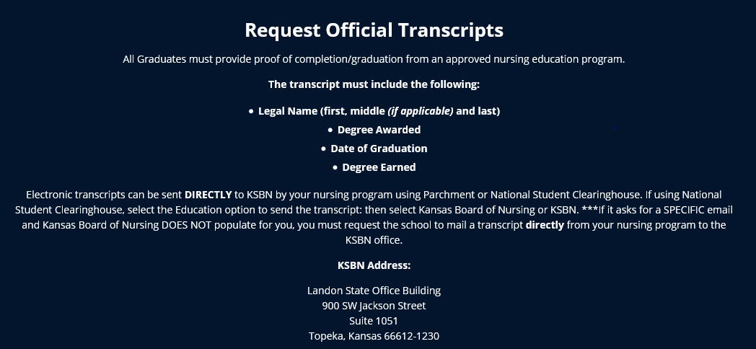
Application Requirements:
1. Transcript

Slide 33
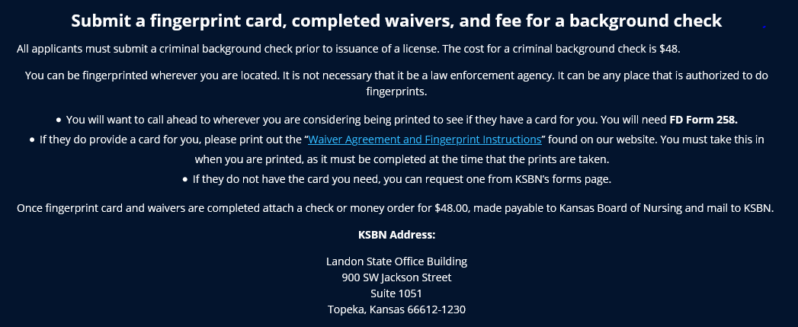

Slide 34
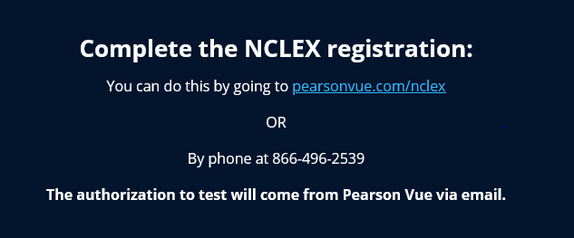

Slide 35
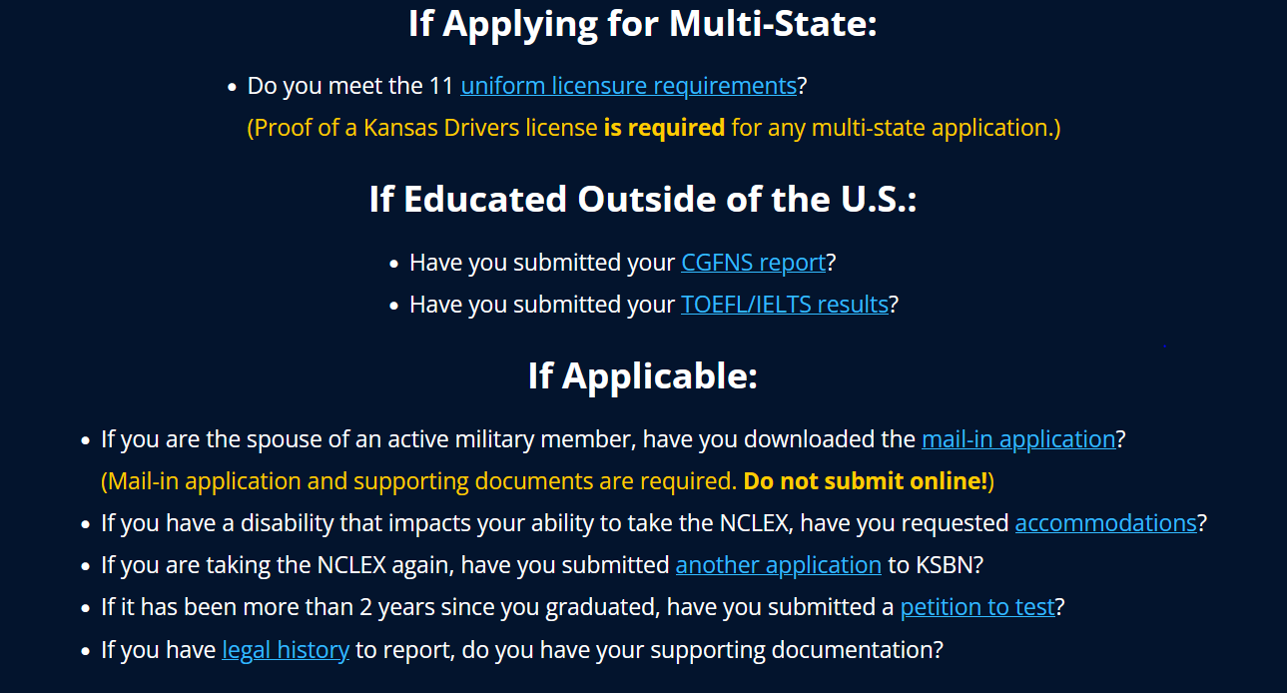
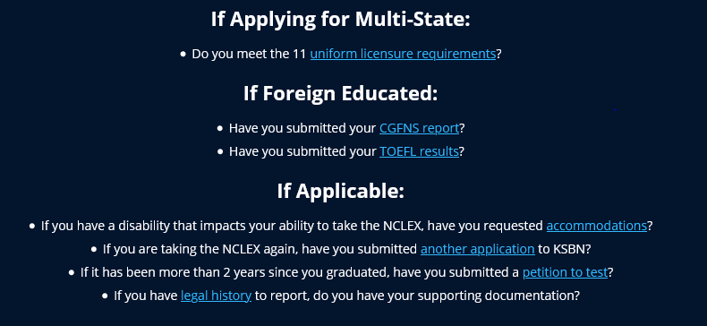

Slide 36
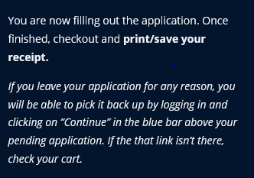
How do I submit the online application?

Slide 37
Multistate vs. Single State
A single state will only allow you to practice in the State of Kansas.
Can apply with any states Drivers license and any states address. Does not have to claim Kansas as Primary state of Residence.
A multistate license will allow to practice in Kansas and other participating compact states.
Must have Kansas Drivers License, Kansas address, and claims Kansas as Primary State of Residence to be eligible and must meet all the Uniform License Requirements

Slide 38
Not sure where to apply?
https://www.ncsbn.org/nursing-regulation/licensure/nurse-licensure-guidance.page

Slide 39
My application is submitted, what now???
Applications are processed within 10 business days of being received and are processed in the order they are received.
Checking your application status can be done by logging into your portal page and clicking “View Checklist” above your pending application. Please allow 7-10 business days to pass before logging in to check the status.
The My Portal tab is in the toolbar on the home page.

Slide 40
What’s on the checklist?
Application Received/Reviewed
License fee
Fingerprint card received
Fingerprint fee
Transcript from School of Nursing
Passed NCLEX
ULR Requirements Met (only on Multistate)
Eligible for Exam
Exam Eligibility sent to Pearson Vue
Investigative Review (if applicable)
Background check received
Approved to License

Slide 41
In order to test:
KSBN must have received and processed a completed application, received an official transcript with degree and graduation date or the school can send a signed/authorized ATT, and applicant must have paid Pearson Vue.
Applicants will not be made eligible unless these three things are received!
If the school prefers to send ATT’s for student to be eligible the school will put a date on the form that KSBN cannot make you eligible to test until then! Please get with your school regarding the date they choose! An official transcript is still required for licensure!

Slide 42
I am eligible and have set my test date, now what?..
Pearson Vue results are updated within 3 business days of you taking your test. If you have passed it will show as completed on your checklist. If you have failed it will remain blank and you will receive a letter in the mail with your results.
If you receive a Fail letter:
A new application must be submitted to KSBN
If applying for multistate licensure a new set of fingerprints and fee will need to be submitted. (If submitting for single state licensure the previous prints on file are good for 6 months.)
You will need to re-register with Pearson Vue. You will not be allowed to take the test any sooner than 45 days from the previous test date.
Transcripts are NOT required to be submitted again.

Slide 43
I passed, but where is my license?!!!!
Congratulations!
REMEMBER- Many factors determine licensure!
You can refer to your checklist at any time to see what is still needed! It is updated as we receive requirements!
You may have tested off an ATT, but we have not received an official transcript…
Your application could have gone to legal, and we are still waiting approval…
Or we may still be waiting on the results of your background check.

Slide 44
I have my license!!...but I thought it was valid for two years?!
Kansas renews according to the month and the year that you were born, and depending on when you are licensed, we must get you into the renewal cycle. Everyone’s expiration date is different!
Kansas will not issue a license for less than 6 months which means you may not get a full 2 years the first time the license is issued!
We do not pick people to get longer licensure dates! Be sure to check your expiration date and renew! You will get notice 90 days prior to renewal so be sure to keep the Board up to date with any address or email changes. (You can do this by signing in to the “My Portal” anytime.)

Slide 45
But what about???...
I received a single state- but now want to apply for multistate?
You would need to submit a conversion application and another set of fingerprints for a background check. If you meet the ULR’s you would be eligible for the multistate.
Kansas is not my primary state of residence and I hold another states drivers license, can I still test here and be licensed?
Of course! You would only be eligible for single state here in Kansas unless you changed your drivers license OR you can reach out to your home state and apply for licensure there. (If your home state is a compact state you could use that license here in Kansas once it is issued.)

Slide 46
I am moving to another compact state…what happens to my Kansas multistate?
You can start work on your Kansas multistate license right after moving! But you do need to contact the Board of Nursing in the state that you moved to as you do have to obtain compact licensure through that state. You cannot hold two compact licenses and once you change your primary state of residence you must change your license.
I have a Kansas single state license and am moving to another state that is not compact…what happens to my license?
Nothing! If you continue to renew, your Kansas license will be active, but you cannot use that license to work in another state. If you choose not to renew the license will go into a lapsed status. You would need to contact the Board of nursing in the state that you moved too, to obtain licensure in that state.

Slide 47
That was a lot of information!
Please reach out if there are any questions!
RaeAnn Byrd, CPM
Kansas Board of Nursing
785-296-6573
Raeann.byrd@ks.gov

Slide 48
Education Update
Janelle Martin, MHSA, RN
Education Compliance Officer

Slide 49
NCLEX Reminders
Program Report Codes – on quarterly NCLEX reports
Multi-Year Pass Rates: https://ksbn.kansas.gov/programs/
Lists multi-year pass rates for each of the pre-licensure nursing programs in Kansas
Reviewed by Board for Calendar Year – approved at March meeting and updated annually on website after approval
NCSBN website – NCLEX stats and comparative information
https://www.ncsbn.org/publications/2024_NCLEX_Pass_Rates

Slide 50
Faculty Qualification Report
The FQR has a slight change in process beginning 8/29/24 – this is a temporary process
Change in vendors for applications used for the FQR – new vendor process not quite ready to go
Fillable PDF forms – complete, electronically sign and save
Same spot on the website – has FQR form, Degree plan form and Hire exception form (still requesting within 30 days of appointment (date hired as faculty)
Please do not submit documents separately – need FQR, transcripts and degree plan or hire exception if applicable

Slide 51
Faculty Qualification Report
Reminders:
For Initial FQR - Include copies of original transcripts for initial RN licensure degree and any further education
Copy of approved FQR will be returned to you for your records – should be kept in faculty file
https://ksbn.kansas.gov/fqr_instructions/
https://ksbn.kansas.gov/wp-content/uploads/2024/08/FQR.pdf
For Update FQR – fill out the top sections for license and employment – do not need transcripts unless the update is for a degree plan completion or new education

Slide 52
Faculty Degree Plan
Must submit with an initial or update FQR
(https://ksbn.kansas.gov/wp-content/uploads/2024/08/Degree-Plan.pdf )
If the faculty member does not have the appropriate degree as defined in 60-2-103 and is enrolled in a program to obtain appropriate degree, a faculty degree plan should be submitted
Must be enrolled in the program (if not enrolled yet must submit Hire Exception) with degree completion within six (6) years of appt. date
Upon completion of the degree, a copy of the transcript showing completion of degree and date of completion should be submitted with an Update FQR
Notification and rationale for each faculty member not following the submitted degree plan should be sent to KSBN (update FQR)

Slide 53
Faculty Hire Exception
Reminders:
Must be submitted with an FQR
Should be submitted when a faculty member does not meet criteria as stated in 60-2-103
Hire exception will be reviewed by Education Compliance Officer and approved/ not approved/ deferred to Board
If approved, hire exception is good for one year
When hire exception expires, another hire exception must be submitted if person is retained as faculty
Please be specific when completing rationale, qualifications, and plan for recruitment (this is the primary reason for the one year limit of the HE)
https://ksbn.kansas.gov/wp-content/uploads/2024/08/Hire-Exception.pdf

Slide 54
Major Curriculum Change
Should be submitted for the following changes:
Any change in the plan of nursing curriculum organization that involves philosophy, number of semesters of study, or delivery method of a nursing course
Any change in content requiring a change in clock-hours or credit hours in nursing courses
Any change in the number of students to be admitted to the nursing education program
Must be submitted at least 30 days before a scheduled board meeting with supporting documentation as per directions (if more than 15 pages, please submit by mail)
https://ksbn.kansas.gov/wp-content/uploads/Education/Major_Curriculum_Changes.pdf

Slide 55
Minor Curriculum Change
Should be submitted for minor curriculum changes that involve:
Content
Course title
Objectives or outcomes
Submitted to Education Compliance Officer for review and approval, denial or deferral to the Board
– may be submitted by email
https://ksbn.kansas.gov/wp-content/uploads/Education/Minor_Curriculum_Change.pdf
Notes:
Working on an electronic submission for Major and Minor CC requests..

Slide 56
IV-Therapy in PN Programs
PN Program IV Therapy Roster
submitted electronically no earlier than 30 days prior to graduation date
rosters reviewed weekly for new graduates who are licensed – manual process
https://ksbn.kansas.gov/pn-program-iv-therapy-roster/ - goes to Stacy Johnson (stacy.johnson@ks.gov)

Slide 57
Annual Report
Discussed in 60-2-108 and 60-17-109
To be submitted on or before JUNE 30th each year
New annual report process beginning 2021 – working with NCSBN on gathering Core Data
NO secure log-in required
Plan to have new FAQ document for the Annual Report by next spring

Slide 58
Other:
Simulation – what counts as replacement for direct clinical time?
Site visits
Piloting new KSBN “self-study” form – uses site visit report template as source document
Moving to virtual repository as primary document source – requested at least 2-3 weeks prior to site visit
Test Before Transcript – refer to RaeAnn’s slides

Slide 59
Other KSBN Education Resources
Link to Resources for Administrators under the Education tab: https://ksbn.kansas.gov/administrator-resources/
ADN Nursing Program Alignment – contains information about the ADN program alignment
PN Core Curriculum – last update 2018 – most recent board decision was to release the core curriculum from mandatory status – programs will be aligned on program outcomes and prerequisite requirements.
Legal Issues Reference Packet
Notes:
Two issues that were found this year related to the questions on “Maximum enrollment” and the five year data for pass rates.

Slide 60
Other Education Resources:
Education > Programs
Multi-Year Pass Rates: https://ksbn.kansas.gov/programs/
Lists multi-year pass rates for each of the pre-licensure nursing
programs in Kansas
Resources > Administrative Resources
Annual Report from KSBN – information about each nursing program: https://ksbn.kansas.gov/annual-report/
KSBN Strategic Plan https://ksbn.kansas.gov/wp-content/uploads/Misc/StrategicPlan.pdf
KSBN Articles https://ksbn.kansas.gov/wp-content/uploads/Resources/articles.pdf

Slide 61
Contacts at KSBN
Executive Administrator Questions:
Carol Moreland, MSN, RN | Executive Administrator
785-296-5752 or carol.moreland@ks.gov
Investigative Process / Practice Questions:
Linda Davies, BSN, RN | Practice Specialist
785-296-8401 or linda.davies@ks.gov
Evan Faulkner | Sr. Special Investigator
785-296-6634 or evan.Faulkner@ks.gov

Slide 62
Contacts at KSBN
Licensing Questions:
Rae Ann Byrd | Licensing Supervisor
785-296-6573 or raeannbyrd@ks.gov
Nursing Program Questions:
Janelle Martin, MHSA, RN | Nursing Education Compliance Officer
785-296-5036 or Janelle.martin@ks.gov
Stacy Johnson, KSBN Administrative Assistant / Education
785-296-3782 or stacy.johnson@ks.gov

